Slide 1
Lecture 7
ARTIFICAL INTELLIGENCE AND Knowledge Management

Slide 2
Concepts and Definitions of Artificial Intelligence
Knowledge-based systems (KBS)
Technologies that use qualitative knowledge rather than mathematical models to provide the needed supports

Slide 3
Concepts and Definitions of Artificial Intelligence
Artificial intelligence (AI) definitions
  Artificial intelligence (AI)
  The subfield of computer science concerned with symbolic reasoning and problem solving
  Turing test
  A test designed to measure the “intelligence” of a computer هي طريقة لتحديد ما اذا كان الحاسب قادر على التفكير مثل الانسان أم لا؟

Slide 4
Artificial Intelligence Characteristics
Symbolic processing المعالجة الرمزية
  Computers process numerically, people think symbolically
  Computers follow algorithms
    Step by step
  Humans are heuristic
    Rule of thumb
    Gut feelings
    Intuitive
    التمثيل الرمزي :
    حيث تتعامل تلك البرامج مع رموز تعبر عن المعلومات المتوفرة لديها ، وهو تمثيل يقترب من شكل تمثيل الإنسان لمعلوماته المعتادة في حياته اليومية .( أنظمة الادراك البصرى – تقهم اللغة الطبيعية ...)
Heuristics
  Symbols combined with rule of thumb processing
Inference
  Applies heuristics to infer from facts
Machine learning
  Mechanical learning
  Inductive learning
  Artificial neural networks
  Genetic algorithms
10-<number>
Notes:
المعالجة الرمزية
برمجيات الذكاء الاصطناعى تعتمد على مجموعة من الرموز غير العددية لتمثيل المعرفة والمعلومات التي يمكن أن يؤديها الانسان وتمثيل المهام التي يمكن ان يقوم بها الانسان وهذا عكس ما هو معروف ومقبول في معظم حواسيب اليوم التي تتعامل مع الكميات العددية والأرقام.
الاستدلال
الاستدلال هو عملية استخراج جواب أو نتيجة بناء على معلومات معروفة مسبقا وقد تكون صحيحة أو خاطئة.
ويشير مصطلح الاستدلال المبني على نموذج إلى طريقة الاستنتاج المستخدمة في النظم الخبيرة استنادًا إلى نموذج من العالم المادي.
قابلية الاستدلال
Inferencing
وهي القدرة على استنباط الحلول الممكنة لمشكلة معينة ومن واقع المعطيات المعروفة والخبرات السابقة ولاسيما للمشكلات التي لا يمكن معها استخدام الوسائل التقليدية المعروفة للحل. هذه القابلية تتحقق على الحاسوب بخزن جميع الحلول الممكنة إضافة إلى استخدام قوانين أو استراتيجيات الاستدلال (Inference Rules & Strategies) وقوانين المنطق.

Slide 5
The Artificial Intelligence Field
Applications of artificial intelligence
  Expert system (ES)
  A computer system that applies reasoning methodologies to knowledge in a specific domain to render advice or recommendations, much like a human expert. A computer system that achieves a high level of performance in task areas that, for human beings, require years of special education and training
Notes:
نظام حاسوبي يطبق منهجيات منطقية على المعرفة في مجال معين لتقديم المشورة أو التوصيات ، يشبه إلى حد كبير خبير بشري. نظام كمبيوتر يحقق مستوى مرتفعًا من لاداء المهام التي يمكن ان يقوم بها البشر والتي تتطلب منه التعليم والتدريب لادائها.

Slide 6
The Artificial Intelligence Field
Applications of artificial intelligence
  Natural language processing (NLP)
  Using a natural language processor to interface with a computer-based system
  Two subfields of NLP
    Natural language understanding
    Natural language generation
  Speech (voice) understanding
  Translation of the human voice into individual words and sentences understandable by a computer

Slide 7
The Artificial Intelligence Field
Neural computing
  Neural (computing) networks
  An experimental computer design aimed at building intelligent computers that operate in a manner modeled on the functioning of the human brain. See artificial neural networks (CANN)

Slide 8
The Artificial Intelligence Field
Game playing
  One of the first areas that AI researchers studied
  It is a perfect area for investigating new strategies and heuristics because the results are easy to measure

Slide 9
The Artificial Intelligence Field
Intelligent agent (IA)
An expert or knowledge-based system embedded in computer-based information systems (or their components) to make them smarter

Slide 10
Artificial Intelligence Concepts
Sensory systems
  Vision, tactile, and signal processing systems
Robotics
  Sensory systems combine with programmable electromechanical device to perform manual labor
10-<number>

Slide 11
Artificial Intelligence Concepts
Language translation
  Programs that translate sentences from one language to another without human interaction
Fuzzy logic
  Extends logic from Boolean true/false to allow for partial truths
  Imprecise reasoning
  Inexact knowledge
Genetic algorithms
  Computers simulate natural evolution to identify patterns in sets of data
10-<number>

Slide 12
Fuzzy Logic Systems
Rule-based technology that can represent imprecise values or ranges of values by creating rules that use approximate or subjective values
Used for problems that are difficult to represent by IF-THEN rules
Notes:
المنطق الضبابى على عكس المنطق الكلاسيكى الذى يعبر عن الأشياء بقيمة واحدة ( خطأ أو صواب ) ( 1 أو صفر) فهو يعتمد على الأساليب الكمية لتحليل الأنظمة أو اصدار قرارات
بينما المنطق الضبابى متعدد القيم بين صفر وواحد فهو يحدد درجة عضوية العنصر للمجتمع الذى ينتمى اليه ويمثل هذا المنطق طريقة لتوصيف وتمثيل الخبرة البشرية كما أنه يقدم الحلول العملية للمشاكل الواقعية ( وقد طبق في برمجة العديد من الأجهزة والمعدات كالغسالات والسيارات والتكييفات ... الخ)
مثلا لو افترضنا ان درجة الحرارة المثالية هي 25 درجة مع قبول كل القيم التي تكون بين 20 و 30 درجة على انها تمثل قيما لدرجة حرارة طقس معتدل

Slide 13
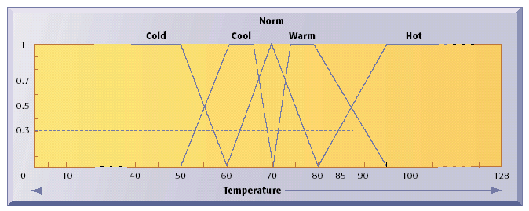
Implementing Fuzzy Logic Rules in Hardware
Figure 12-14

Slide 14
Neural Networks
Neural Network:
Hardware or software that emulates the processing patterns of the biological brain to discover patterns and relationships in massive amounts of data
Use large numbers of sensing and processing nodes that interact with each other

Slide 15
Neural Networks (Continued)
Uses rules it ‘learns” from patterns in data to construct a hidden layer of logic that can be applied to model new data.
Applications are found in medicine, science, and business.

Slide 16
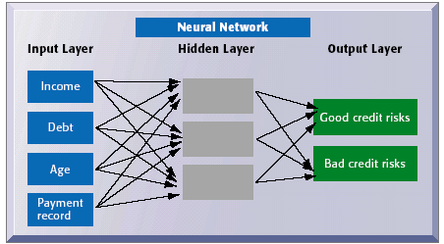
How a Neural Network Works
Figure 12-15

Slide 17
Genetic Algorithms
Adaptive computation that examines very large number of solutions for a problem to find optimal solution
Programmed to “evolve” by changing and reorganizing component parts using processes such as reproduction, mutation, and natural selection: worst solutions are discarded and better ones survive to produce even better solutions
Notes:
وهو أسلوب يماثل فكرة عمل الكروموزوم التي تتكون منها الخلايا في الكائنات الحية والتي تحتوى على بعض الجينات الوراثية
DNA التي يرثها الأبناء من الإباء
وبالتالي فإن الجينات الخوارزمية تعبر عن الخصائص التي ينتمى في ضوئها المتغير للمجتمع الذى يمثلة .

Slide 18
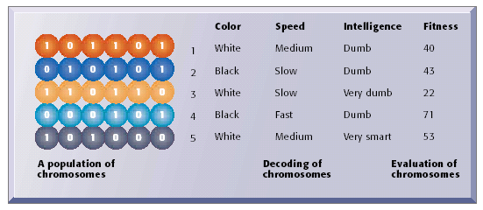
The Components of a Genetic Algorithm
Source: Dhar, Stein, SEVEN METHODS FOR TRANSFORMING CORPORATE DATA INTO BUSINESS INTELLIGENCE (Trade Version), 1st copyright 1997. Electronically reproduced by permission of Pearson Education, Inc., Upper Saddle River, New Jersey.
Figure 12-16

Slide 19
Hybrid AI system:
Integration of multiple AI technologies (genetic algorithms, fuzzy logic, neural networks) into a single application to take advantage of the best features of these technologies

Slide 20
Expert Systems

Slide 21
Basic Concepts of Expert Systems (ES)
The basic concepts of ES include:
  How to determine who experts are
  How expertise can be transferred from a person to a computer
  How the system works

Slide 22
Definition
An expert system is software that attempts to reproduce the performance of one or more human experts, most commonly in a specific problem domain.
An intelligent technique for capturing tacit knowledge in a very specific and limited domain of human expertise

Slide 23
Definition
Use human knowledge to solve problems that normally would require human intelligence
Represent the expertise knowledge as data or rules within the computer
  Can be called upon when needed to solve problems

Slide 24
Expert Systems Features
Experts
  Have special knowledge, judgment, and experience
  Can apply these to solve problems
    Higher performance level than average person
    Relative
    Faster solutions
    Recognize patterns
Expertise
  Task specific knowledge of experts
    Acquired from reading, training, practice
  Capable of making expert level decisions
10-<number>
Notes:
1- النظام الخبير نوع من برامج الحاسب
2- حيازة معرفة الخبير ،حيث يستوعب النظام الخبير و يخزن المعرفة المتراكمة للخبير الإنساني ،كما يستطيع العمل بكفاءة في حقل الاختصاص.
3- التركيز على الخبرة يعمل عل حل المشكلات في مجال معين ،لكنه لا يملك خارج إطار المجال التخصصي.
4- لديه القدرة على التعامل مع معلومات رمزية مثل :الرسومات الهندسية التي تظهر على شاشة الحاسوب و استخلاص النتائج من هذه الرسومات.
5- القدرة على التصرفات الذكية مثل اقتراح أفكار و مدا خيل جديدة لحل المشاكل بناءا على معلومات معينة مثل ما تفعله النظام الخبيرة في المجال الطبي.
6- تنمية بدائل الحلول و تقييمها و اقتراح الحل الملائم من بينها حيث يتوفر النظام الخبير على المنطق الذي يسمح بذلك.

Slide 25
Expert Systems Features
Symbolic reasoning
  Knowledge represented symbolically
  Reasoning mechanism symbolic
Deep knowledge
  Knowledge base contains complex knowledge
Self-knowledge
  Able to examine own reasoning
  Explain why conclusion reached

Slide 26
Why we need ES
  ES are an excellent tool for preserving professional knowledge crucial to a company's competitiveness أداة ممتازة للحفاظ على المعارف المهنية الحاسمة للقدرة التنافسية للشركات
  ES is an excellent tool for documenting professional knowledge for examination or improvement
  ES is a good tool for training new employees and disseminating knowledge in an organization
  ES allow knowledge to be transferred more easily at a lower cost

Slide 27
Areas for ES applications
  Finance
  Data processing
  Marketing
  Human resources
  Manufacturing
  Homeland security
  Business process automation
  Health care management

Slide 28
Areas for ES applications (Cont..)
Finance
  Insurance evaluation, credit analysis, tax planning, financial planning and reporting, performance evaluation
Data processing
  Systems planning, equipment maintenance, vendor evaluation, network management
Marketing
  Customer-relationship management, market analysis, product planning
Human resources
  HR planning, performance evaluation, scheduling, pension management, legal advising
Manufacturing
  Production planning, quality management, product design, plant site selection, equipment maintenance and repair
10-<number>

Slide 29
Applications of Expert Systems
DENDRAL project
  Applied knowledge or rule-based reasoning commands
  Deduced likely molecular structure of compounds
MYCIN
  Rule-based system for diagnosing bacterial infections
XCON
  Rule-based system to determine optimal systems configuration
Credit analysis
  Ruled-based systems for commercial lenders
Pension fund adviser
  Knowledge-based system analyzing impact of regulation and conformance requirements on fund status
10-<number>

Slide 30
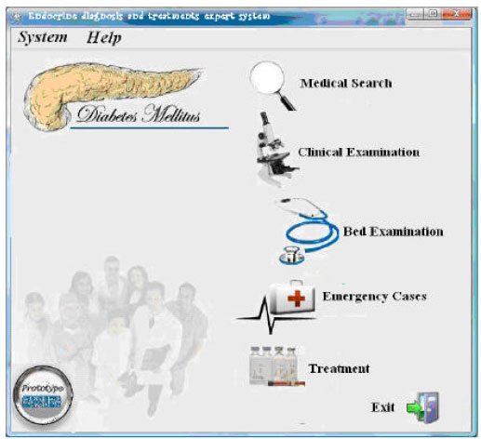
MYCIN ES

Slide 31
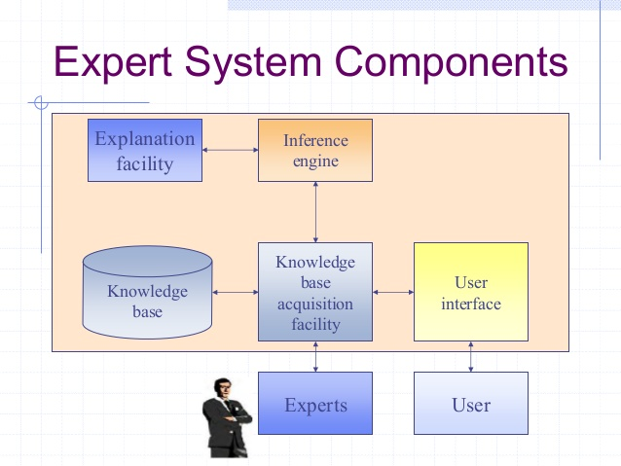
مكونات النظم الخبيرة

Slide 32
Structure of ES
Knowledge acquisition (KA)
The extraction and formulation of knowledge derived from various sources, especially from experts
Knowledge base
A collection of facts, rules, and procedures organized into schemas. The assembly of all the information and knowledge about a specific field of interest

Slide 33
Structure of ES
Inference engine
The part of an expert system that actually performs the reasoning function
User interfaces
The parts of computer systems that interact with users, accepting commands from the computer keyboard and displaying the results generated by other parts of the systems

Slide 34
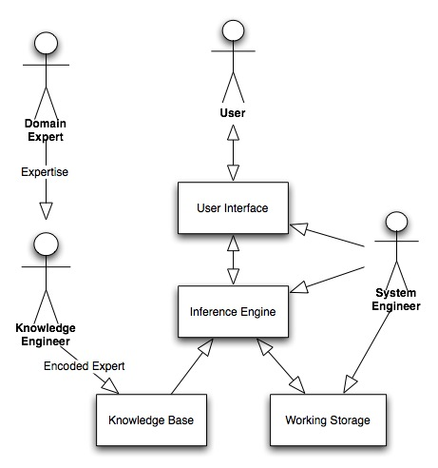
Components and Human Interfaces

Slide 35
How ES Work:
Inference Mechanisms
The inference process
Inference is the process of chaining multiple rules together based on available data

Slide 36
How ES Work:
Inference Mechanisms
The inference process
  Forward chaining
  A data-driven search in a rule-based system
تستعمل هذه الطريقة عندما تحتوي المشكلة على شروط أو فرضيات قليلة واستنتاجات كثيرة
  Backward chaining
  A search technique (employing IF-THEN rules) used in production systems that begins with the action clause of a rule and works backward through a chain of rules in an attempt to find a verifiable set of condition clauses

Slide 37
Inference Engine
Forward chaining
  Looks for the IF part of rule first
  Selects path based upon meeting all of the IF requirements
Backward chaining
  Starts from conclusion and hypothesizes that it is true
  Identifies IF conditions and tests their veracity
  If they are all true, it accepts conclusion
  If they fail, then discards conclusion
10-<number>

Slide 38
General Problems Suitable for Expert Systems
يتم بناء النظام الخبير لحل مجموعة من المشاكل والقيام ببعض الأنشطة المناسبة :
Interpretation systems
  Surveillance, image analysis, signal interpretation
Prediction systems
  Weather forecasting, traffic predictions, demographics
Diagnostic systems
  Medical, mechanical, electronic, software diagnosis
Design systems
  Circuit layouts, building design, plant layout
Planning systems
  Project management, routing, communications, financial plans

Slide 39
General Problems Suitable for Expert Systems
Monitoring systems
  Air traffic control, fiscal management tasks
Debugging systems ازالة الأعطال
  Mechanical and software
Repair systems
  Incorporate debugging, planning, and execution capabilities
Instruction systems نظم التدريب والتعليم
  Identify weaknesses in knowledge and appropriate remedies
Control systems
  Life support, artificial environment
10-<number>

Slide 40
Benefits of Expert Systems
Increased outputs
Increased productivity
Decreased decision-making time
Increased process and product quality
Reduced downtime
Capture of scarce expertise
Flexibility
Ease of complex equipment operation
Elimination of expensive monitoring equipment
Operation in hazardous environments
Access to knowledge and help desks
10-<number>

Slide 41
Benefits of Expert Systems
Ability to work with incomplete, imprecise, uncertain data
Provides training
Enhanced problem solving and decision-making
Rapid feedback
Facilitate communications
Reliable decision quality
Ability to solve complex problems
Ease of knowledge transfer to remote locations
Provides intelligent capabilities to other information systems
10-<number>

Slide 42
Limitations
Knowledge not always readily available
Difficult to extract expertise from humans
  Approaches vary
  Natural cognitive limitations
  Vocabulary limited
  Wrong recommendations
Lack of end-user trust
Knowledge subject to biases
Systems may not be able to arrive at conclusions
10-<number>

